Slide 1
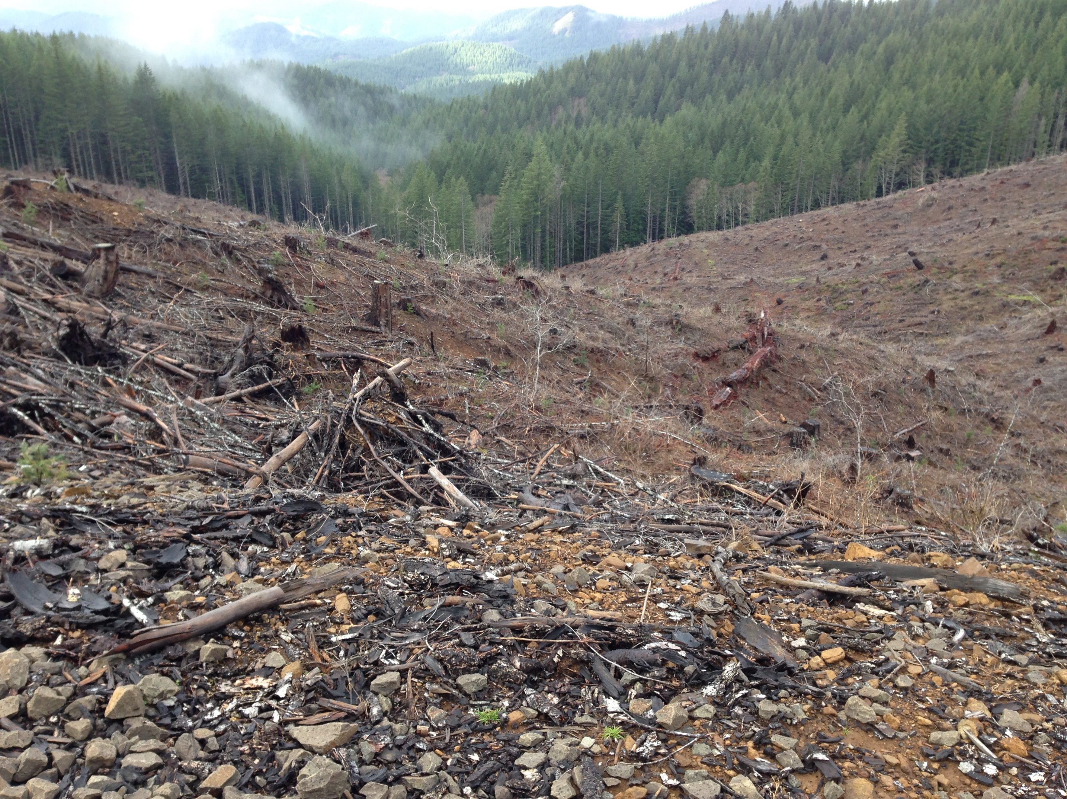
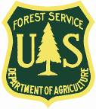
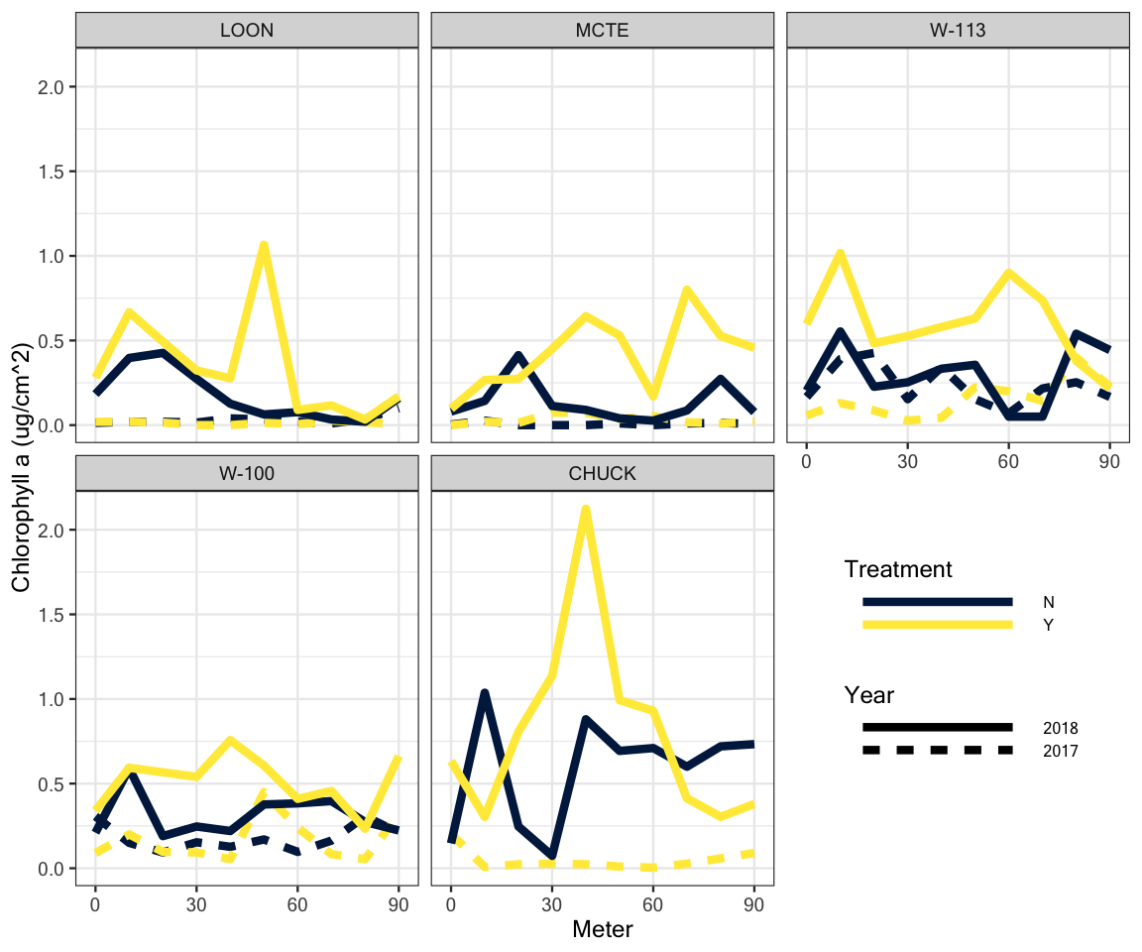
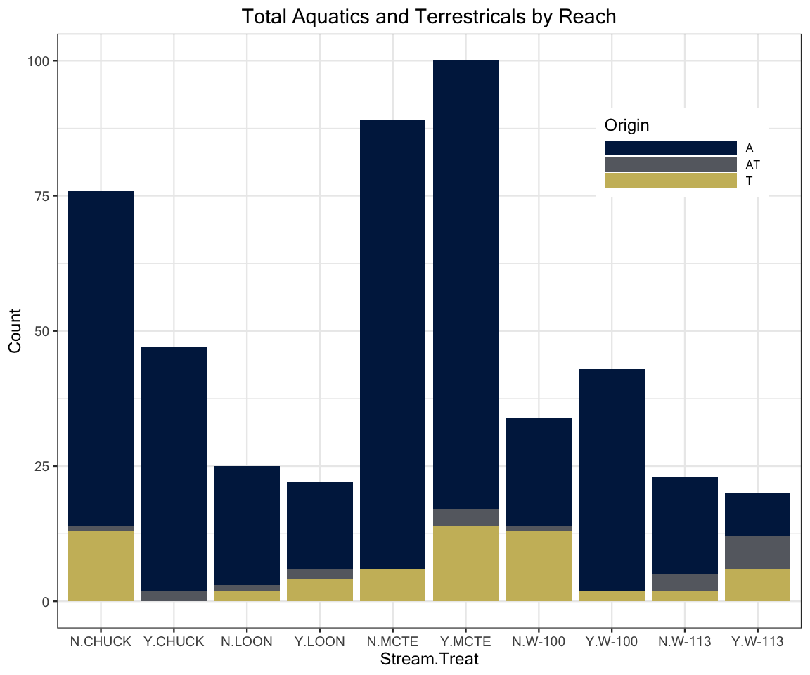
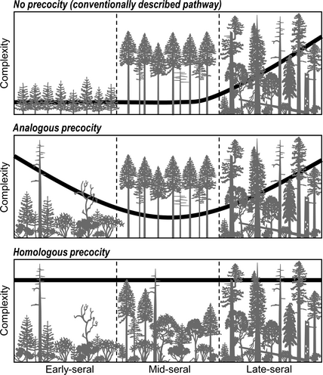
Effects of Light on Fish Diets and Macroinvertebrate
Community Assemblage
Cedar Mackaness^{1*}, Allison Swartz², Dave Roon & Dana R. Warren²
¹College of Earth, Ocean & Atmospheric Sciences - Oregon State University 2, Department of Forests Ecosystems and Society - Oregon State University
*corresponding author: mackanec@oregonstate.edu
Background
Riparian forests in the PNW have been heavily harvested, leaving dense, second growth vegetation that shades out streams. As these forests undergo stand development, tree mortality and natural disturbances will increase canopy heterogeneity and light availability.
Figure 1. Illustration showing second growth forests with closed canopies, and old-growth/mature stands with canopy gaps allowing light to reach the stream benthos.
Under current conditions we would expect: dense canopies → light limited GPP → low abundance of herbivorous invertebrates.
Results – Chlorophyll
Results – Diets
Description of results
Figure 3. Total Chlorophyll in treated (Y) and control (N) reaches for 2017 and 2018. *Note missing 2017 control data at CHUCK.
Results – Invertebrates
Conclusions
Limited response overall
Study Questions
How do riparian forest canopy gaps affect local stream invertebrate communities?
Are any changes in the invertebrate community manifested in fish diets?
Hypothesis: Canopy gaps increase light availability which increases the abundance of grazing invertebrates, and these changes are reflected in fish diets.
Methods
BACI study design across 5 reach pairs over 2 years. A canopy gap (~30 m. diameter) was cut in the treatment reach in between sampling years.
Benthic samples were taken with a Surber Sampler and diets were collected via gastrolavage.
Benthic samples were ID’ed to LTU, diets were ID’ed to the family level.
Analyses were performed
in R using the Vegan package
Acknowledgements:
References:
Figure 2. Study area in western Cascade mountains of Oregon

